Slide 1
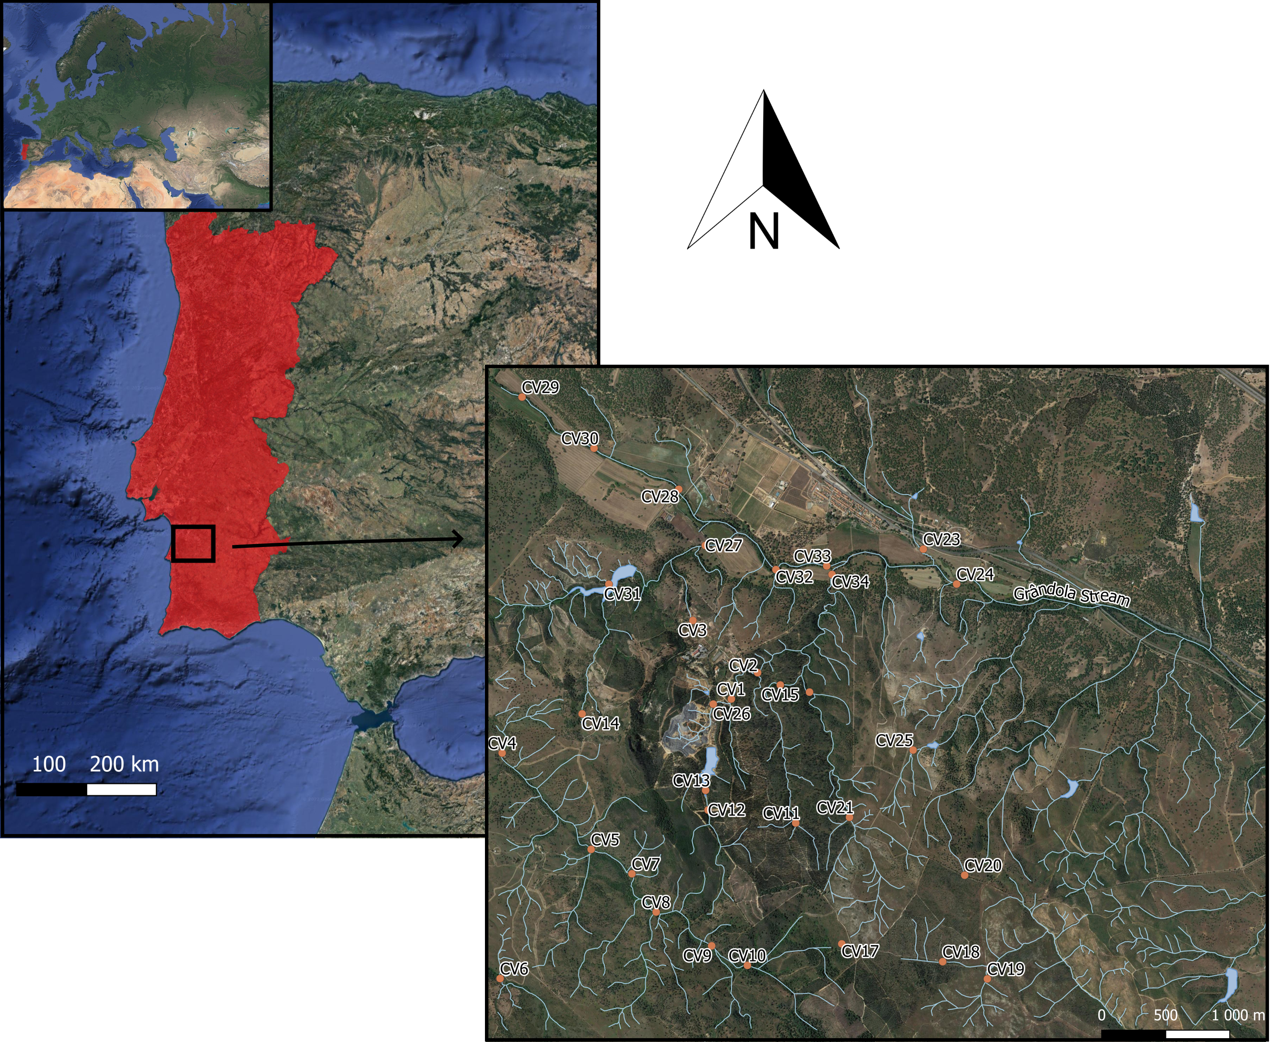
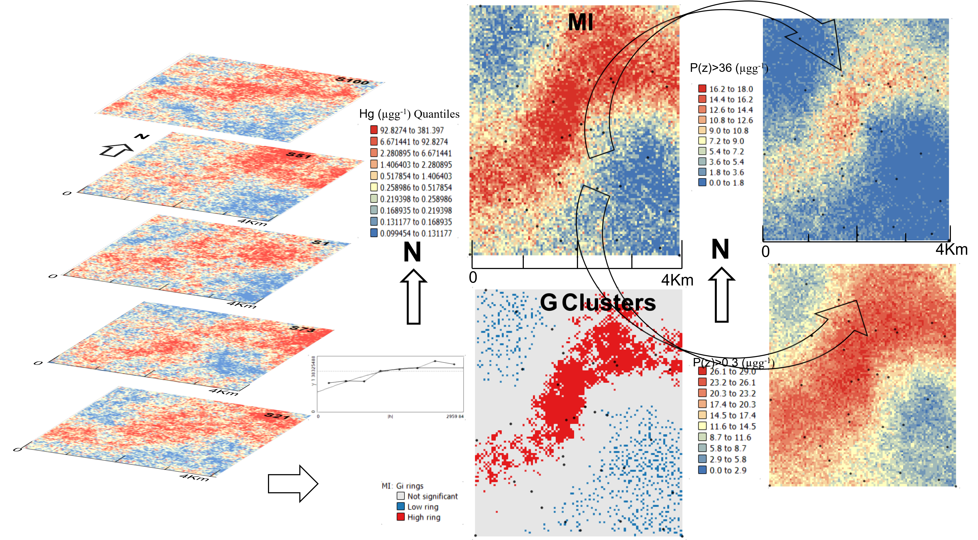
A geostatistical approach for mercury spatial patterns assessment in sediments in an old mining region -the Caveira mine case study, Portugal
Mota, Natália¹; Fonseca, Rita¹; Araújo, Joana¹;; Antunes, Margarida²; Valente, Teresa²; Barroso, Ana²; Araújo, Alexandre¹;Albuquerque, Teresa^{2,3}
¹ICT/University of Évora, Évora, Portugal
²ICT/University of Minho, Braga, Portugal
³Polytechnique Institute of Castelo Branco, Castelo Branco, Portugal
Abstract
Mercury pollution is significant in many former mining communities worldwide, including in developing countries. Anthropic contributions to environmental Hg pollution are mostly connected to fuel fossil emissions, and industrial and mining activities. Among mining operations, gold exploration contributes to the highest Hg contamination rates, given the processes, widely used in the past, of mixing Hg with the gold-containing ore, to separate this metal from the bulk impurities. This study, as part of the GeoMaTre project, an ongoing collaborative network (2021-2024) between the Polytechnic Institute of Castelo Branco and the University of Évora, Portugal, aimed to evaluate the potential risk of mercury pollution in stream sediments in the Caveira area, an abandoned Cu, Pb, Zn, Ag, and Au mine, included in the Iberian Pyrite Belt, at South Portugal. This mine corresponds to a Gossan developed on pyrite mineralization, with high gold and silver content at the official beginning of its exploitation, in 1863, having exhausted the reserves in these precious metals in the 1920s. Until the date of its abandonment (1966) the exploitation focused on the remaining metals (Cu, Pb, Zn) and S. Currently, the surrounding area of the Caveira mine is essentially composed of areas of waste accumulation, from mining activity, with little or no vegetation.
Thirty-three sediment samples were collected from within 0 to 10 cm depth, in a grid of 1Km x 1Km. Hg was determined in samples preserved at about -8 ºC at the time of collection, through a mercury analyzer (NIC MA-3000) based on thermal decomposition, gold amalgamation, and cold vapor atomic absorption spectroscopy detection.
A spatial multivariate preliminary study was conducted to evaluate the spatial distribution of Hg in the mine area and to determine the spatial clusters of Hg concentration. Analysis showed very high values (50-130µgg⁻¹), in the sediments deposited in the mainstream crossing the mine heaps, with concentrations reaching 340 µgg⁻¹ in the meeting with the major waterway of the region. In the latter, near the confluence zone, there is an attenuation of Hg levels, although still above the reference values for sediments, 0.3µgg⁻¹, according to the Netherlands Regulation (2009), followed by many European countries. Since this is a complex mining area with diffuse distribution of the water system, levels significantly higher than reference values were also found in other small streams in the vicinity of the mine heaps. According to the Hg limits established by this regulation, mitigation measures are required when Hg is greater than 36µgg-1. Therefore, to identify spatial patterns of the Hg concentration distribution, geostatistical modeling was used throughout conventional variography followed by the Sequential Gaussian Simulation (SGS). The Mean Image of the one hundred performed simulations followed by local G clustering allowed the definition of the significant hotspots for contamination risk. The probability maps of exceeding, respectively, the 0.3µgg⁻¹ (maximum admissible value) and the 36µgg⁻¹ thresholds were computed and acted as a measurement of the obtained clusters’ robustness, thus providing a faster and more intuitive way to verify whether the previously detected problematic zones are true of concern and in need of mitigation.
Key-words – Caveira mine; Mercury; Sequential Gaussian Simulation; G clustering; Probability map.
Introduction
In the last two centuries, industry, mining and traffic have left a notable anthropogenic footprint, which is reflected across environmental compartments. Mining is a frequent source of potentially toxic elements (PTEs), i.e. metallic elements or metalloids which can seriously disturb the environment and pose a threat to human health when present in high concentrations. Among PTEs, Hg is a highly toxic element, even at very low concentrations. Moreover, it is easily absorbed, biomagnified, and bioaccumulated within the food chain. Given these considerations, the EU launched a strategy in 2005 to reduce Hg emissions. In addition, under the recent UN Minamata Convention on Mercury (2017), countries are required to put into place measures to control sources of Hg pollution, thus renewing interest in studying this pollutant (Boente et al, 2019). The Caveira mine case study, an abandoned Cu, Pb, Zn, Ag, and Au mine, included in the Iberian Pyrite Belt, in southern Portugal, aimed at evaluating the potential risk of mercury pollution in stream sediments and its bioavailability and toxicity. To this end, here we propose a geostatistical methodology approach for the establishment of Hg spatial hot-spots, and probability maps of exceeding defined thresholds.
Characteristics of the data and the study area
The data set used in this study is located in the region of Caveira Mine, SW Portugal. A dataset of 33 samples was collected from within 0 to 10 cm depth, in a grid of 1Km x 1Km and thirteen chemical elements, including PTEs of variable toxicity (As, Cd, Co, Cr, Cu, Hg, Mn, Ni, Pb, Zn, V) and major elements from lithogenic sources (Fe, Al), were analyzed in preserved samples at about 4°C. The most extractable forms of metals (except for Hg) were obtained by partial digestion with aqua regia (HCl and HNO₃) in a high-pressure microwave digestion unit, followed by ICP-OES analysis. Hg was analyzed in frozen samples and determined by a mercury analyzer based on thermal decomposition, gold amalgamation, and cold vapor atomic absorption spectroscopy detection.
Spatial modeling - a geostatistical approach
The spatial characterization of Hg distribution was performed through a 3-step approach (Albuquerque et al, 2017):
In the first step, experimental variograms were computed for variable structural characterization. No clear evidence of anisotropies was found, an isotropic variogram was computed and the corresponding model was fitted,
A hundred simulations were performed using Sequential Gaussian Simulation (SGS) as a conditional stochastic simulation of the Hg value distribution for The calculation of the spatial uncertainty - the Standard Deviation of each pixel – set aside the discussion of local accuracy and, finally,
Local G clustering identified the Hg high-rings for the selected elements in the subject area.
Conclusions
The present study sought to provide a group of tools to assess the environmental impact of derelict mines. The methodology used synchronized classical geochemistry and geostatistical /spatial statistic methodologies for the purpose of identifying Hg spatial patterns. Significant hot spots were identified along and downstream the Grândola river, through the old mine’s heaps as well as a probability of exceeding the limit of 36 (µgg⁻¹) Hg content by around 20%.
References
C. Boente, M.T.D. Albuquerque, S. Gerassis, E. Rodríguez-Valdés, J.R. Gallego (2019). A coupled multivariate statistics, geostatistical and machine-learning approach to address soil pollution in a prototypical Hg-mining site in a natural reserve, Chemosphere 218, 767e777, https://doi.org/10.1016/j.chemosphere.2018.11.172
Albuquerque, M.T.D., Gerassis, S., Sierra, C., Taboada, J., Martín, J.E., Antunes, I.M.H.R., Gallego, J.R., 2017. Developing a new Bayesian Risk Index for risk evaluation of soil contamination. Sci. Total Environ. 603e604, 167e177. https://doi.org/10.1016/j.scitotenv.2017.06.068

