Slide 1
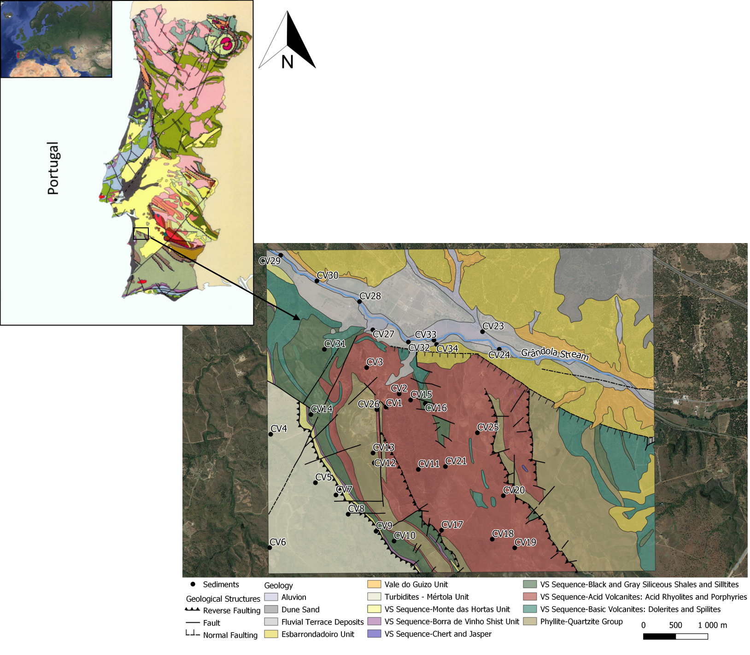
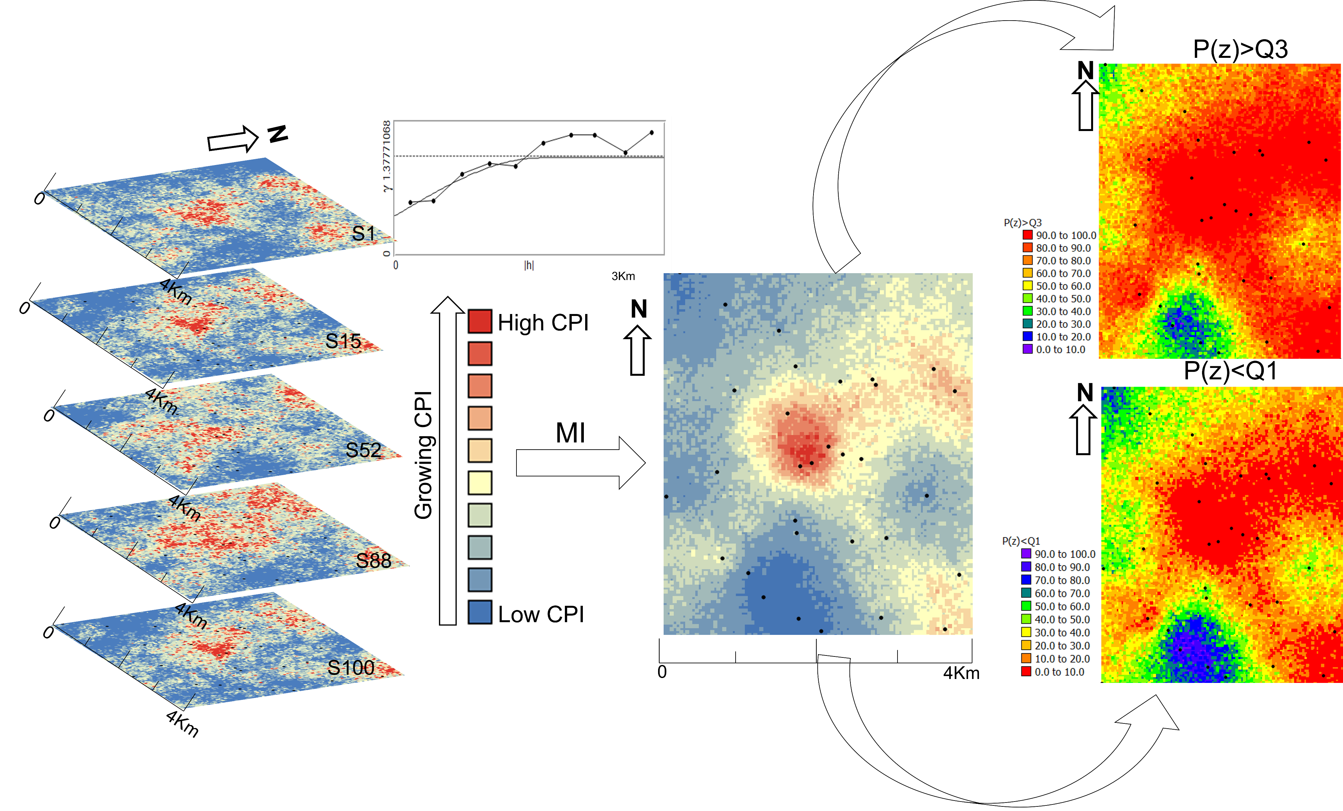
Stream sediments pollution: a compositional baseline assessment at the Caveira mine, Portugal
Araújo, Joana¹; Fonseca, Rita¹; Mota, Natália¹; Araújo, Alexandre¹; Antunes, Margarida²; Valente, Teresa²; Barroso, Ana²; Albuquerque, Teresa^{2,3}
¹ICT/University of Évora, Évora, Portugal
²ICT/University of Minho, Braga, Portugal
³Polytechnique Institute of Castelo Branco, Castelo Branco, Portugal
Abstract
A high concentration of Potentially Toxic Elements (PTEs) can affect ecosystem health. It is therefore essential that spatial trends of pollutants are assessed and controlled. River sediment pollution is widespread in mining communities around the world, including in developing countries. This study, as part of the GeoMaTre project, restoration of water bodies impacted by mine drainage, an ongoing collaborative project (2021-2024) between the Polytechnic Institute of Castelo Branco and the University of Évora, Portugal, aimed to evaluate the potential risk of PTEs pollution in stream sediments under the direct influence of Caveira mine, a Cu-Pb-Zn-Ag-Au old mine included in the Iberian Pyrite Belt, South Portugal. Quantifying pollution implies first the understanding of pollution-free stream sediment. Often, this background, or pollution baseline, is undefined or only partially known. Given that the concentration of chemical elements is compositional, as the attributes vary together, a compositional approach was used aiming to find a compositional balance, based on Compositional Data (CoDa) principles. A dataset of 33 samples was collected from within 0 to 10 cm depth, in a grid of 1Km x 1Km and thirteen chemical elements, including PTEs of variable toxicity (As, Cd, Co, Cr, Cu, Hg, Mn, Ni, Pb, Zn, V) and major elements from lithogenic sources (Fe, Al), were analyzed in preserved samples at about 4°C. The most extractable forms of metals (except for Hg) were obtained by partial digestion with aqua regia (HCl and HNO₃) in a high-pressure microwave digestion unit, followed by ICP-OES analysis. Hg was analyzed and determined by a mercury analyzer based on thermal decomposition, gold amalgamation, and cold vapor atomic absorption spectroscopy detection. Very high levels of Pb, As and Hg were found in sediments in a stream closer to the mine tailings pile and in an accumulation area where it flows into a larger waterway. These concentrations, reaching 3.8% Pb, 750µgg⁻¹ As and 340 µgg⁻¹ Hg, are well beyond the intervention values imposed by the Netherlands legislation (2009), one of the only European legislation that includes reference values for freshwater sediments. In some of these locations, Zn contents above the legislated reference values (120 µgg⁻¹) corroborate the nature of the ore previously exploited, pyrite mineralization enriched in Cu, Pb, Zn, Au, and Ag. The methodological approach implied the geological background selection in terms of a trimmed subsample that can be assumed as non-pollutant (Al and Fe) and the selection of a list of pollutants based on the based on expert knowledge and previous studies (As, Zn, Pb, and Hg); Identifying a compositional balance, including pollutant and non-pollutant elements, with sparsity and simplicity as properties, is crucial for the construction of the novel Compositional Pollution Indicator (CPI). A sequential stochastic Gaussian Simulation was performed on the new CPI. The results of the 100 computed simulations are summarized through mean image maps and probability maps of exceeding a given statistical threshold, thus, allowing the characterization of the spatial distribution and variability of the CPI. A better understanding of the trends of relative enrichment and PTEs fate is discussed.
Key-words – Caveira mine; Stream sediment; Compositional Indicator; Sequential Gaussian Simulation; Probability map.
Introduction
The continuous accumulation of Potentially Toxic Elements (PTEs) in distinct environmental matrices over time has compromised the health of living organisms and ecosystem quality, to the point that these substances now pose nowadays a major environmental concern worldwide. The persistence and non-biodegradability of PTEs have resulted in a continuous increase in soil concentrations and thus an increased risk to human and environmental health. Maps are a powerful means of visually depicting the spatial distribution of pollutants and are a useful tool for supporting policy development and vulnerabilities for environmental complexes. In geochemistry, a common strategy for representing the distribution of PTEs is to calculate a range of contamination indices or indicators. A new composition pollution indicator based on stream sediments background’s definition is presented here to address contamination issues.
Since their introduction (Aitchison, 1982), Compositional Data (CoDa) theories have seen a development towards a better understanding of the sample space of compositional data and their structure (Egozcue and Pawlowsky-Glahn, 2006). Moreover, the great advantage of compositional indicators that involve geochemical backgrounds, like the CPI, is that they are scale-invariant and subcompositionally coherent, implying that a change in units of the concentrations will not modify the result of the analysis.
Characteristics of the data and the study area
The data set used in this study is in the region surrounding Caveira Mine, Portugal. A dataset of 33 samples was collected from within 0 to 10 cm depth, in a grid of 1Km x 1Km and thirteen chemical elements, including PTEs of variable toxicity (As, Cd, Co, Cr, Cu, Hg, Mn, Ni, Pb, Zn, V) and major elements from lithogenic sources (Fe, Al), were analyzed in preserved samples at about 4°C. The most extractable forms of metals (except for Hg) were obtained by partial digestion with aqua regia (HCl and HNO₃) in a high-pressure microwave digestion unit, followed by ICP-OES analysis. Hg was analyzed and determined by a mercury analyzer based on thermal decomposition, gold amalgamation, and cold vapor atomic absorption spectroscopy detection.
Compositional Data
The early fundamentals of compositional data can be found in the seminal work by Aitchison (1986). The analysis of a stream sediment sample, given by its chemical composition should be conducted under the assumption that these data are compositional. As a result, when performing data analysis, the functions used to describe the composition should be invariant under multiplication by a positive constant. Also, any composition can be expressed in proportions (components adding to 1) without adding or losing any information and irrespective of the units in which the data were initially represented.
The CPI balance was obtained based on expert criteria attending a selection of elements (Boente et all, 2022), of which some are considered pollutants while others are not. In the case of the Caveira mine, the main contaminants were selected from typical pollutants namely, As, Zn, Pb, and Hg, while Al and Fe were selected as the main natural-source elements (or non-pollutants). Based on this previous study, the selected balance, CPI, was constructed as follows:
Spatial modeling - a geostatistical approach
The computed Compositional Pollution Indicator (CPI) is unbounded, a real random variable. Therefore, it fulfills the assumptions underlying a conventional geostatistical approach. Their spatial probability patterns were computed following a two-step geostatistical modeling method:
Structural analysis and experimental variograms computation.
2. Sequential Gaussian Simulation (SGS) is used as a stochastic simulation algorithm. SGS starts by computing the univariate experimental distribution of values and performing a normal score transformation of the original values to a standard normal distribution. Normal scores at grid node locations are then simulated sequentially with simple kriging (SK) using the normal score data and a zero mean. Once all normal scores have been simulated, they are back-transformed to their original units.
$${CPI}_{}=\sqrt{\frac{4}{3}}\ln\left(\frac{{(As Zn Pb Hg)}^{1/4}}{{\left(Al Fe\right)}^{\frac{1}{2}}}\right)$$
Conclusions
Geochemical data are compositional data, as the concentrations of elements in any environmental matrix are commonly expressed as parts of a whole and vary together. Once this feature is established, compositional data procedures can be applied to obtain indicators that address pollution, for example, in stream sediment. The method was tested with 33 sediment samples and up to 13 chemical elements from the old Caveira mine in Portugal.
A high risk of contamination is observed along the Grândola river and in the vicinities of the mine’s tailings. It is important to consider agricultural and organic stocks as the main economic activities for establishing two lines of intervention: 1. installation of the surveillance network for continuous control in the all area; 2. define mitigation actions for the northern area where high levels of contamination are observed.
References
Aitchison, J. (1982). The statistical analysis of compositional data (with 736 discussion). J R STAT SOC B 44 (2), 139{177
Egozcue, J. J. and V. Pawlowsky-Glahn (2006). Simplicial geometry for compositional data. In Compositional Data Analysis in the Geosciences: From Theory to Practice, Volume 264 of Special Publications, pp. 145{159. Geol. Soc., London.
Boente C., Albuquerque M.T.D., Gallego J.R., Pawlowsky-Glahn V., Egozcue J.J., 2022, Compositional baseline assessments to address soil pollution: An application in Langreo, Spain, STOTEN, Volume 812, 15 March 2022, 152383

